Slide 1

Introducing the 2024 Health Care Affordability State Policy Snapshot
OCTOBER 23, 2024
Healthcare Value Hub

Slide 2
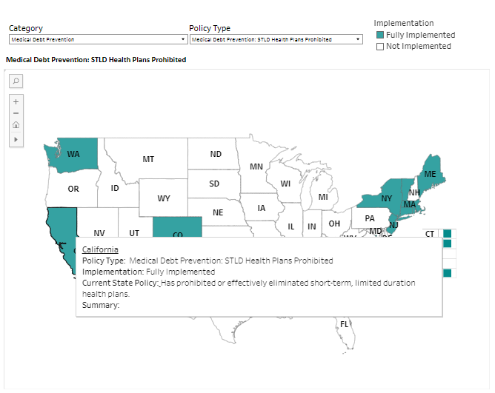
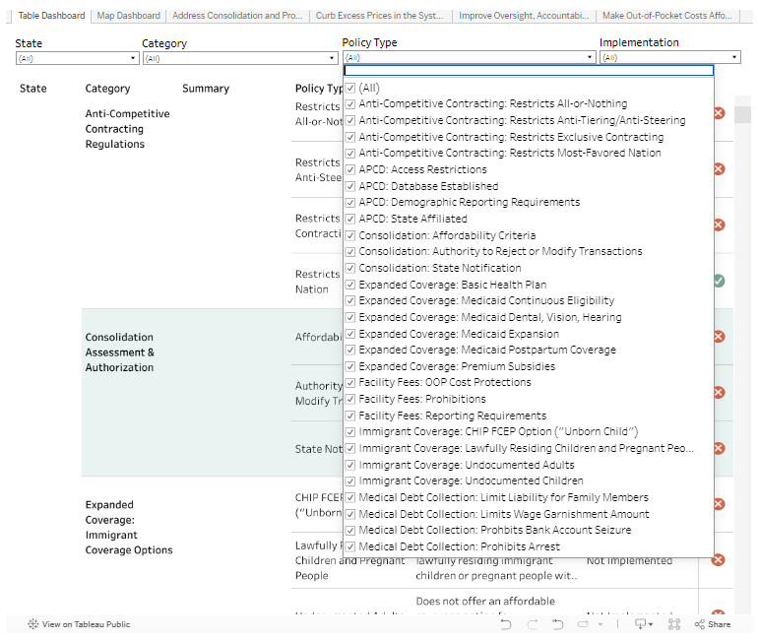
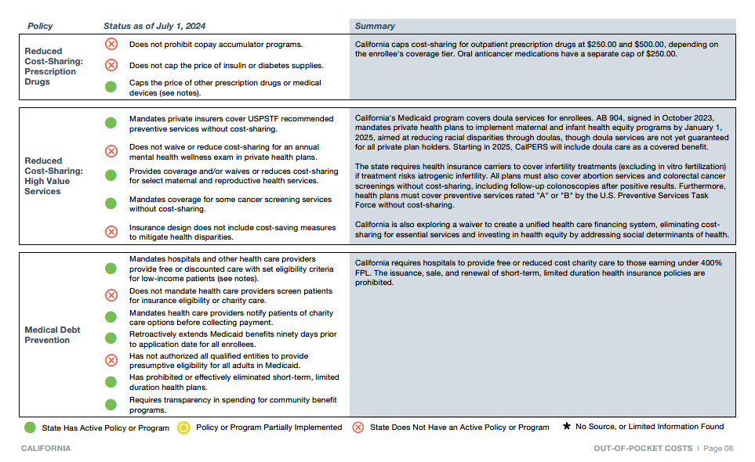





Agenda
Welcome – Beth Beaudin-Seiler, PhD – Director Healthcare Value Hub
A Few Words From our Funder – Morgan McGrath, Arnold Ventures
Live Demonstration – Alexandra Allen, Health Policy Analyst, Healthcare Value Hub
Q&A
Notes:
The Health Care Value Hub (“the Hub”) is proud to launch the 2024 Health Care Affordability Policy Snapshot (“Affordability Snapshot”) which replaces the annual Healthcare Affordability Scorecard (“Scorecard”). The Affordability Snapshot provides legislators, consumer advocates, regulators and other stakeholders a tool to compare their state’s health policies across other states.
The categories examined in this resource explore a variety of policy options that have previously appeared in the Scorecard, as well additional policies that impact health care affordability.

Slide 3
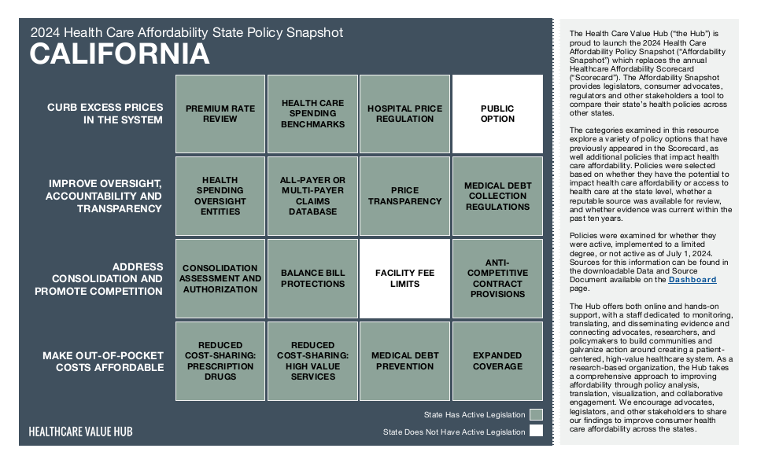
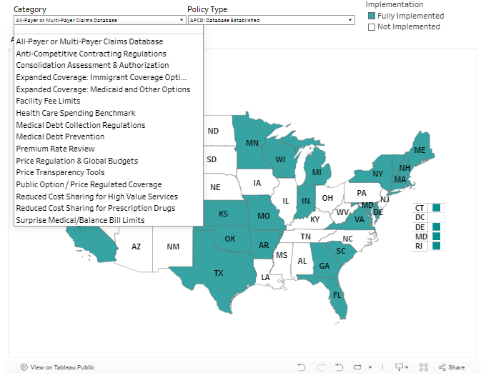
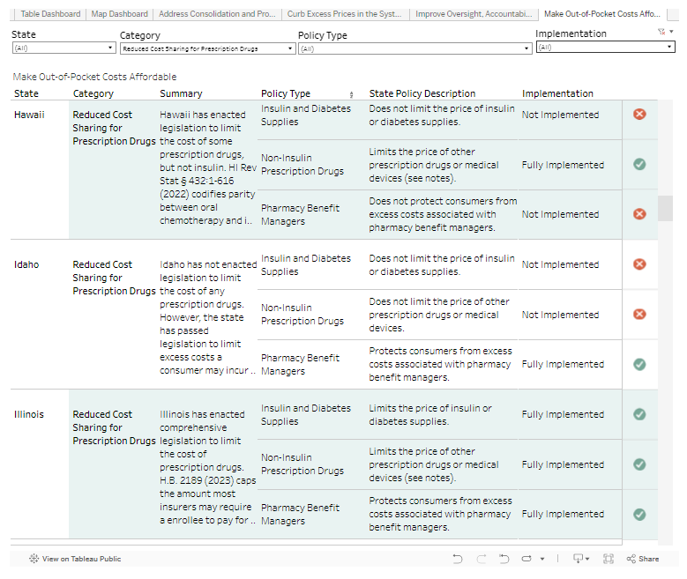
What is the Health Care Affordability
State Policy Snapshot?
Replaces the annual Healthcare Affordability Scorecard
Includes policy options from the Scorecard and new policies affecting health care affordability.
Policies are grouped into one of four categories based on their intended impact:
  Improve Oversight, Accountability, and Transparency
  Curb Excess Prices in the System
  Address Consolidation and Promote Competition
  Make Out-of-Pocket Costs Affordable
Data and notes are available as a PDF or can be accessed through the interactive Affordability Snapshot Dashboard, which allows filtering by various criteria and gives users the option to download the data from the website.
Notes:
The categories examined in this resource explore a variety of policy options that have previously appeared in the Scorecard, as well additional policies that impact health care affordability.
Policies were selected based on whether they have the potential to impact health care affordability or access to health care at the state level, whether a reputable source was available for review, and whether evidence was current within the past ten years. Policies were examined for whether they were active, implemented to a limited degree, or not active as of July 1, 2024. Sources for this information can be found in the downloadable Data and Source Document available on the Dashboard page.
The Dashboard Table allows users to examine multiple states and policies at once and see which states have implemented specific policies, including details on each state’s approach and degree of implementation. Users can filter by State, Category, Policy Type, and implementation to view specific policy types and levels of implementation to compare policy action between different states.

Slide 4
A Word From Our Funder

Slide 5

DEMONSTRATION
Notes:
Pennsylvania_Snapshot.pdf (healthcarevaluehub.org)
At the top of the page we have a brief overview of the details shared by my colleague Britt, as well as a downloadable glossary of terms and topics so that users can quickly find anything they’re not familiar with.
*scroll down* First, we have our main dashboard. The dashboard allows users to see multiple states and policies at once and quickly compare which states have implemented specific policies, including details on each state’s approach and degree of implementation.
The columns include:
State
Category, which captures all of the different policies we evaluate;
Policy Type, which captures the specific components of each policy;
State Policy Description, which described what the state is doing for each component;
Summary, which provide additional notes about the state’s policy or efforts to establish one;
And finally, Implementation Status and icons, which capture whether the policy has been enacted.
Notably, Partial implementation is granted in cases where there is evidence that further expansion of the policy would have a greater impact on health care affordability, such as: active policies that are available to some, but not all, people within the population it is intended to serve; policies that do not include all components that make them effective at improving affordability; and policies that limit some, but not all, of a practice that can make care less affordable.
3. Below the dashboard, we have a map of all 50 states plus DC which allows users to see one policy at a time across all states and DC as a visual map.
4. Lastly, we have PDF Snapshots for each state so that users can review a state’s entire portfolio of affordability policies.
Let’s run through an example demonstration for a user who is researching health care policy in Pennsylvania.
Query Pennsylvania results in total.
Table: First, the user asks, What policy opportunities HAS my state implemented? [Pennsylvania, Status: Active and Partially Implemented]. Here we can see the full list of policies PA has pursued.
Table: Next, the user might ask What policy opportunities has my state NOT implemented? [Pennsylvania, Status: Not active] We change the implementation status to Not Active, and see
Let’s look at All Payer Claims Database (APCD) as an example.
Map: As a first step in assessing where Pennsylvania is in relation to other states on APCDs, the user might ask Which states have an APCD? [scroll down to map, Category: APCD, Policy Type: Database Established] Here, we see that many other states have active APCDs, and we can hover over each one to see additional details.
Looking at this map, the user might want to know How does my state compare to another state of interest? They might select Utah, another state that, like Pennsylvania, is somewhat politically conservative but still innovating in the healthcare affordability space.
Table: To compare two different states, we would return to the dashboard table, add Utah to our selection, and select Category: APCD. Now we can see side by side comparison.
If the user wants a quick reference of the comparison, they can also export to PDF.
Snapshot PDFs: Lastly, the user might want to more closely review Pennsylvania’s entire portfolio of policies to see if there are any other policies of interest. They can go down to the bottom of the page, open Pennsylvania’s snapshot, and read all of the details in one place. This is also easily printable for sharing with other stakeholders.
Lastly, sources are available in the downloadable spreadsheet at the top of the home page.
And that’s our demo! We will now welcome questions and comments.
{DONE]

Slide 6
Questions?
Thank you!
Dashboard Link:
https://www.healthcarevaluehub.org/affordability-snapshot
Contact Information:
Dr. Beth Beaudin-Seiler, Director, Altarum Healthcare Value Hub
Beth.Beaudin-Seiler@altarum.org
Alexandra Allen, Policy Analyst, Altarum Healthcare Value Hub
Alexandra.Allen@altarum.org
Kiera Williams, Policy Analyst, Altarum Healthcare Value Hub
Kiera.Williams@altarum.org
Britt Sanderson, Policy Analyst, Altarum Healthcare Value Hub
Britt.Sanderson@altarum.org

