Slide 1
From Shortage to Strength: ARPA Investments in the Home Care Workforce Across the Southern United States

Slide 2
Stephen McCall
Brieanne Lyda-McDonald
Alene Shaheed
Teja Stokes
Senior Analyst Health Economics and Policy Altarum
Project Director North Carolina Institute of Medicine
New York Times Featured Florida-Based Disability Advocate
Deputy Executive Director National Association of State Directors of Developmental Disabilities Services

Slide 3
Supporting the Home Care Workforce Across the Southern United States: Impetus, Exploration and Policy Strategies
Stephen McCall Senior Analyst, Altarum

Slide 4
Background
In the South, 30% of older adults with self care needs live in poverty.
The Coronavirus pandemic intensified existing workforce shortages.
The American Rescue Plan Act (ARPA) provided the largest investment in Medicaid HCBS in American history, including a temporary 10% increase in federal medical assistance percentage (FMAP) for these services.
Notes:
In the South, the poverty rate among older adults aged 65 and older with self-care needs is 30%. These individuals are the most likely to rely on paid assistance with activities of daily living and may struggle to afford it.
The coronavirus pandemic highlighted and intensified workforce shortages, as home care workers left the profession to minimize their risk of exposure to the virus or due to working conditions.
The American Rescue Plan Act (ARPA) provided the largest investment in Medicaid HCBS in American history, including a temporary 10% increase in federal medical assistance percentage (FMAP) for these services. States were expected to spend funds from 2022 to 2025.

Slide 5
Allowable Uses of ARPA Funds
Expand eligibility for HCBS.
Offer a broader range of community-based services.
Strengthen HCBS infrastructure.
Promote community integration.
Strengthen the direct service workforce.
Address social determinants of health.

Slide 6
Measuring Workforce Capacity in the South
Used the American Community Survey 2018–2022 Five-Year Sample.
Compared the number of full-time equivalent home care workers per 1,000 older adults with self-care needs (likely consumers) in Public Use Microdata Areas (PUMAs) in the Southern United States.
Estimated home care workforce capacity in PUMA quartiles based on the percentage of likely consumers who were Black or African American, Hispanic or Latino, immigrants, and living in poverty.
Notes:
For example, the PUMAs in the first quartile had the lowest percentage of likely consumers who were black or African American, while the the 4th quartile had the highest percentage.
This categorization allowed us to analyze variations in workforce capacity relative to demographic composition across different areas.

Slide 7
Key Findings
Workforce capacity varied by state and metropolitan status.
Across nearly all analyses, potential workforce capacity in the South was lower than in other states.
Workforce capacity was HIGHER in areas with larger proportions of likely home care consumers who were:
Immigrants
Hispanic or Latino
Living in Poverty
Workforce capacity was LOWER in in areas with larger proportions of likely home care consumers who were:
Black or African American
Notes:
Workforce capacity was higher in areas with larger proportions of likely home care consumers who were immigrants, Hispanic or Latino, and living in poverty, but lower in areas with a higher proportion who were Black or African American.
Across nearly all these analyses, potential workforce capacity in the South was lower than in other states.

Slide 8
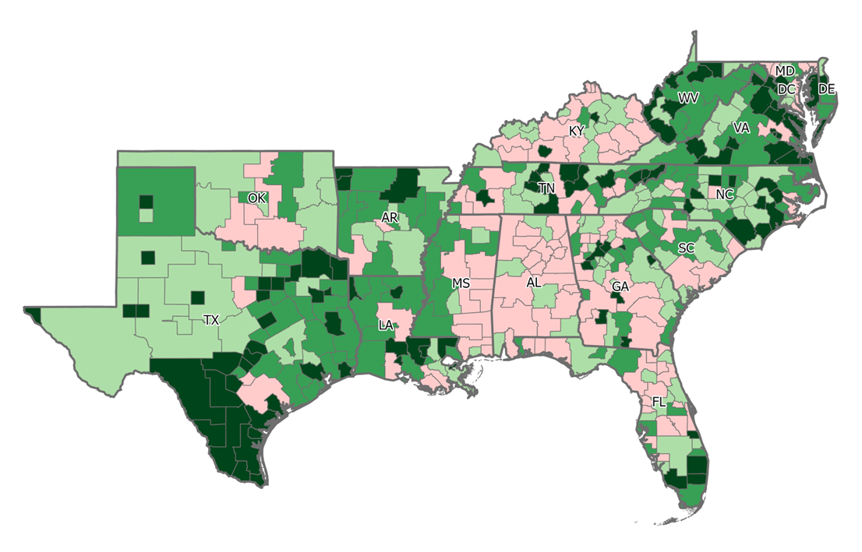
Workforce capacity varied by metropolitan status.
Full-Time Equivalent Home Care Workers Per 1,000 Adults with Self-Care Needs by PUMA, 2018 to 2022
There were 287 home care worker FTEs per 1,000 likely consumers in metropolitan areas, compared to 214 in non-metropolitan areas.
18–112
113–164
165–233
234–712

Slide 9
Workforce capacity varied by state.
Full-Time Equivalent Home Care Workers Per 1,000 Adults with Self-Care Needs by PUMA, 2018 to 2022
The District of Columbia had the highest potential workforce capacity, with a ratio of 570 home care worker FTEs for every 1,000 likely consumers.
Alabama had the lowest capacity at 97 home care worker FTEs per 1,000 likely consumers.
18–112
113–164
165–233
234–712

Slide 10
Areas with fewer Black or African American likely home care consumers had higher workforce capacity.
Home Care Workforce Capacity by PUMA Quartile Based on Percentage of Likely Home Care Consumers Who Were Black or African American, 2018 to 2022

Slide 11
Areas with more Hispanic or Latino likely home care consumers had higher workforce capacity.
Home Care Workforce Capacity by PUMA Quartile Based on Percentage of Likely Home Care Consumers Who Were Hispanic or Latino, 2018 to 2022

Slide 12
Areas with more likely home care consumers who were immigrants had higher workforce capacity.
Home Care Workforce Capacity by PUMA Quartile Based on Percentage of Likely Home Care Consumers Who Were Immigrants, 2018 to 2022

Slide 13
Areas with more likely home care consumers who were living in poverty had higher workforce capacity.
Home Care Workforce Capacity by PUMA Quartile Based on Percentage of Likely Home Care Consumers Who Were Living in Poverty, 2018 to 2022

Slide 14
Uses of ARPA Funds Among Southern States
Each Southern state proposed using ARPA funding to provide incentive payments for workers or establish longer-term reimbursement rate increases for Medicaid HCBS providers.
Some Southern states also proposed using ARPA funding to extend working benefits to home care workers, like childcare support.
Many invested in training and curriculum development to strengthen the workforce.
Most investments in the home care workforce were short-term, but some were made permanent through legislation or waiver amendments.
Notes:
North Carolina and DC were the only states that proposed benefits or supports for home care or direct service workers, which included potential funding for childcare supports (NC) and transportation stipends (D.C.). D.C. has actualized their proposed plan, but to date North Carolina has not established the Direct Care Jobs Innovation Fund (and there appear to be no other updates beyond the ARPA spending plans).

Slide 15
Limitations
We could not account for the availability of family caregivers.
Our estimates of home care workers may not account for some multiple jobholders, and some friends and family members paid through Medicaid programs.
We could not compare workforce capacity before and after Southern states implemented ARPA-funded interventions.

Slide 16
Panel Discussion

Slide 17
Panel Discussion
How does the shortage of home care workers affect the quality of care for recipients, and how does this impact both families and the individuals receiving care?

Slide 18
Panel Discussion
What are the broader economic consequences of an insufficient home care workforce, and how can advocates effectively present these issues to Southern legislators to drive policy changes?

Slide 19
Panel Discussion
What unique challenges do rural areas face compared to urban settings in building a strong home care workforce, and what factors should decision-makers consider when developing workforce initiatives for these settings?

Slide 20
Panel Discussion
What are the most promising ARPA-funded strategies that you’ve seen implemented to strengthen the home care workforce?
What would be needed to introduce or expand similar efforts across the Southern states?

Slide 21
Panel Discussion
What do states need to do to effectively sustain ARPA-funded investments in workforce improvements once ARPA funds are exhausted?

Slide 22
Panel Discussion
Looking ahead, what actions should legislators, advocates, private sector employers, and/or community members prioritize to:
Improve recruitment and retention of home care workers, and (b) quality of care for the individuals they support?

Slide 23
Q&A

Slide 24
Special thanks to our panelists, our funders, the Robert Wood Johnson Foundation, and Webinar attendees. Please send all questions and comments to: Britt.Sanderson@altarum.org Stephen.McCall@altarum.org Beth.Beaudin-Seiler@altarum.org
HubInfo@altarum.org
With support from Arnold Ventures and the Robert Wood Johnson Foundation, the Healthcare Value Hub provides free, timely information about the policies and practices that address high health care costs and poor quality, bringing better value to consumers. The Hub is part of Altarum, a nonprofit organization with the mission of creating a better, more sustainable future for all by applying research-based and field-tested solutions that transform our systems of health and health care.
twitter.com/HealthValueHub
linkedin.com/company/healthcarevaluehub

