Slide 1

Prior Authorization and
Its Impact on Affordability
August 24, 2023

Slide 2
Welcome and Introduction
Elise Lowry
Policy Analyst
Healthcare Value Hub
@HealthValueHub www.HealthcareValueHub.org
Notes:
Hello everyone and welcome to the Healthcare Value Hub’s webinar on prior authorization and its impact on affordability. My name is Elise Lowry and I am a policy analyst here at the hub and I will be moderating today’s webinar. Prior authorization is a much-maligned topic in our health care system by many stakeholders. Today we will be looking at this process and how it impacts consumer affordability.

Slide 3
Housekeeping
Thank you for joining us today!
Please submit your questions in the Q&A chat
Webinar is being recorded and will be shared afterwards
Technical problems?
  Contact Britt Sanderson at Britt.Sanderson@Altarum.org
@HealthValueHub www.HealthcareValueHub.org
Notes:
A little housekeep before we begin. If you have any questions for our panels, please submit them in the Q&A chatbox and we will answer questions at the end. The webinar will be recorded and shared on our website after the event. If you have any technical problems or need assistance with anything, please reach out to Britt Sanderson.

Slide 4

Agenda
Welcome & Introduction
Overview of Prior Authorization
  Kaye Pestaina, KFF
Impact on Consumers
  Caitlin Donovan, National Patient Advocate Foundation
What Can States Do? Vermont’s Experience
  Sebastian Arduengo, Vermont Department of Financial Regulation
Q&A
@HealthValueHub www.HealthcareValueHub.org
Notes:
The agenda of today’s webinar will begin with an overview of prior authorization from Kaye Pest-aye-na from KFF, followed by a look the impact prior authorization has on consumers with Caitlin Donovan from the national patient advocate foundation, and finally, Sebastian Ard-when-go from the VT department of financial regulation will share Vermont’s experience in regulating prior authorization.

Slide 5
An Overview of Prior Authorization
Kaye Pestaina
Vice President
Co-Director, Program on Patient and Consumer Protections
KFF
@HealthValueHub www.HealthcareValueHub.org
Notes:
And with that, I will hand it over to Kaye to get us started.

Slide 6
Prior Authorization Overview
Kaye Pestaina
August 24, 2023

Slide 7
Prior Authorization: The Big Picture
What is prior authorization?
What are current concerns about its use?
What actions have been proposed to address these concerns?
What are insurer reactions to these actions?

Slide 8
Background: Prior Authorization (PA)
PA is a requirement by health plans for patients to obtain approval of a health service or a medication before care is provided. This typically involves the submission of administrative and/or clinical information to the health plan and a coverage determination by the plan (treated as a “claim”).
Purpose: Ensure appropriate use of certain services (e.g. medically necessity) and control costs
Concerns include:
  Cumbersome and slow administrative process can delay care and result in poor health outcomes
  Wide variation and lack of information about what services require PA can create confusion/complexity/increase burdens on providers and patients
  Use of criteria to make PA determinations that is not transparent or is not evidence-based

Slide 9
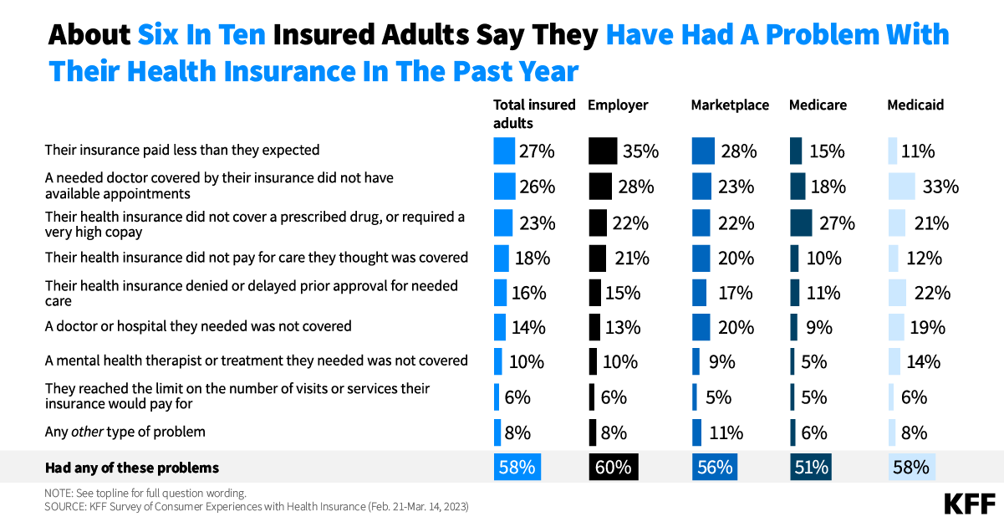
Figure 4
Figure 1
Their health insurance denied or delayed prior approval for needed care
1

Slide 10
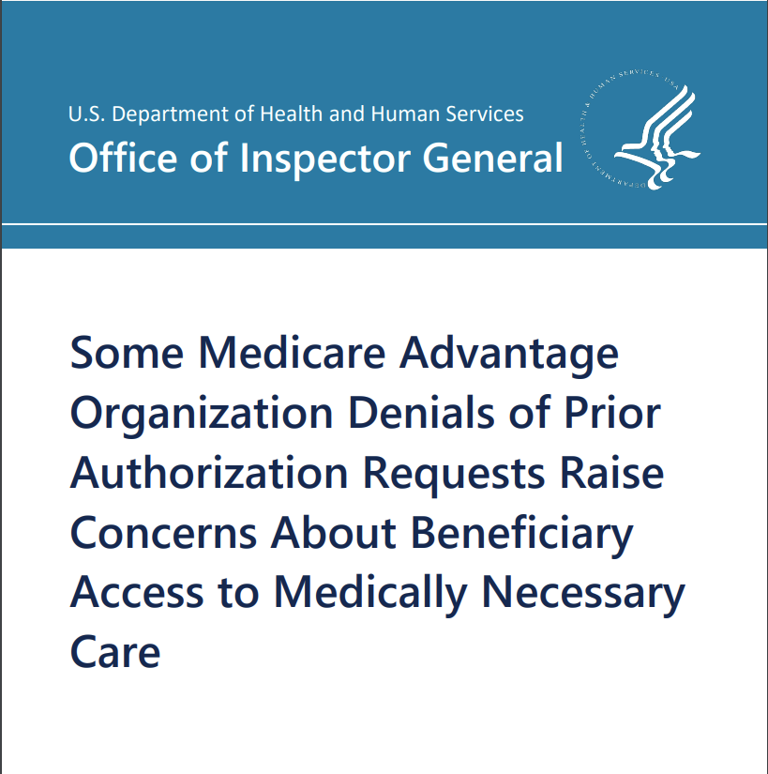

Two OIG Reports Raise Alarm about Prior Authorization

Slide 11
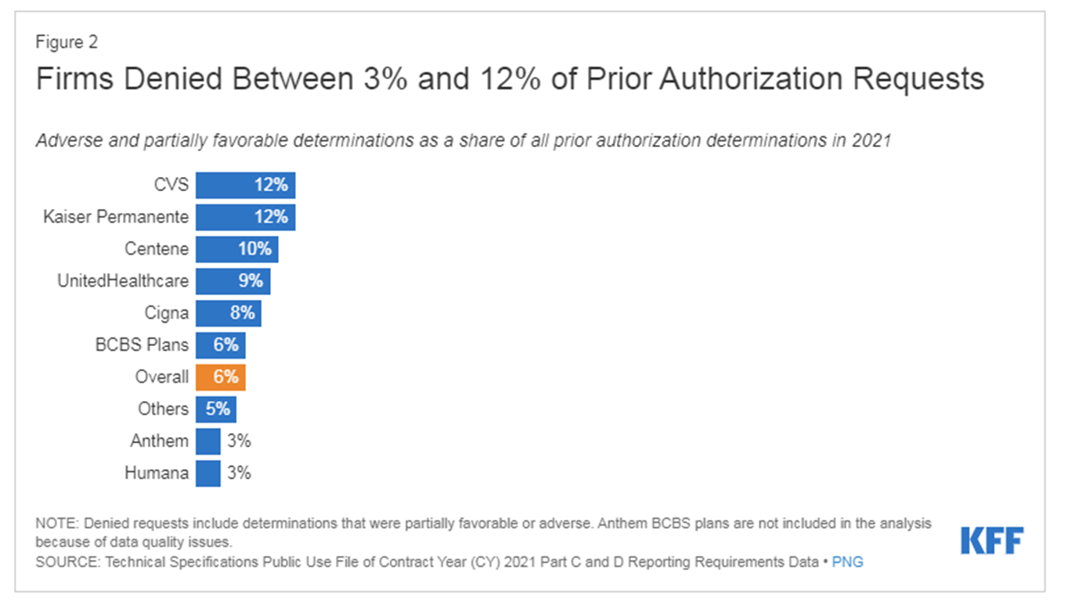
KFF Analysis: Use of Prior Authorization in Medicare Advantage Plans
Figure 2

Slide 12
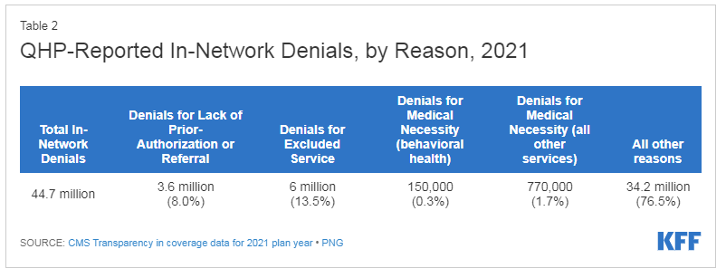
KFF Analysis: Claims Denials for Lack of Prior Authorization for ACA Marketplace Plans
Table 1

Slide 13
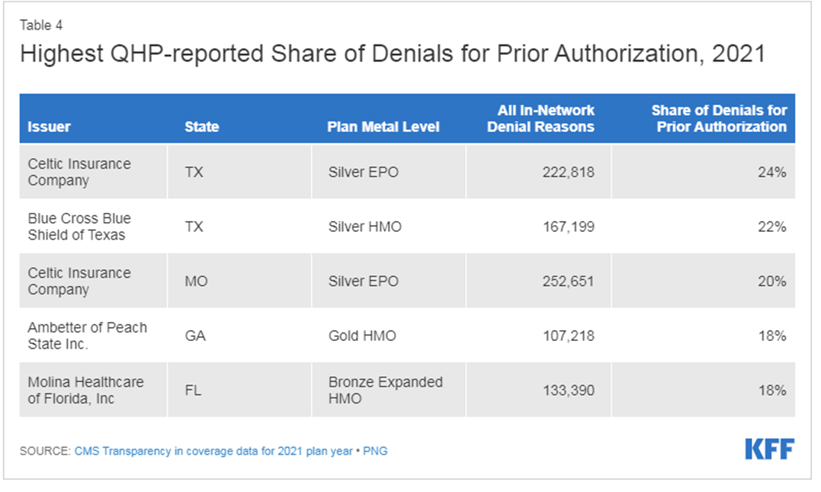
KFF Analysis: Claims Denials for Lack of Prior Authorization for ACA Marketplace Plans
Table 2

Slide 14
Landscape of PA issues:
Transparency: access to information about what services require prior authorization, how the process works, metrics on denial and approval rates, etc.
Process: making the administrative process for conducting prior authorization more efficient, timely, impartial (i.e. automation of process through electronic interface, shorter time frames for decisions, standards for how/who makes a determination)
Criteria for use and evaluation: oversight of criteria used to make prior authorization decisions to prevent overuse or misuse of prior authorization (i.e. limits on use of plan-developed clinical criteria)
Other: prohibitions on prior authorization for certain services; continuity of PA approval when consumer changes plans etc.

Slide 15
Examples of reforms:
Federal
Proposed regulation on “improving prior authorization” (CMS, December 13, 2022) (would apply to Medicare Advantage, Medicaid MCOs & FFS, CHIP, and Marketplace healthcare.gov states) -- standards to automate process, shorten timeframes, transparency reporting [see KFF Brief from 2/21/23]
2024 Medicare Advantage and Part D final regulation (CMS, April 12, 2023) -- clarifications on use of internal coverage criteria for all claims, extends the period that a PA is valid etc.
Mental health parity proposed updates to regulation (CMS/IRS/DOL, August 3, 2023) -- specific standards for treatment limits on behavioral health such as prior authorization (including reporting on claim denials/approvals)
State
Texas “Gold Carding” requirements (other states as well)
Arkansas “Prior Authorization Transparency Act” (2020)
Illinois “Prior Authorization Reform Act” (2021)
Georgia “Ensuring Transparency in Prior Authorization Act” (2021)

Slide 16
Be in touch!
Kaye Pestaina
VP, Program on Consumer & Patient Protections in Health Insurance
kayep@kff.org
202-654-1372
Karen Pollitz
Senior Fellow
karenp@kff.org
202-654-1307
11

Slide 17
Thank you!

Slide 18
Impact on Consumers
Caitlin Donovan
Senior Director, Outreach and Communications
National Patient Advocate Foundation
@HealthValueHub www.HealthcareValueHub.org

Slide 19





PAF
NPAF
Patient Insight Institute
  Case management assistance for patients and caregivers
  Financial assistance through copay relief and funds
  Education and outreach
  Regular events discussing systemic issues
  Policy analysis
  Research and data analysis
  Partnerships with outside institutions
  Helping patients take part in research

Slide 20


45%
percent of patients experience delays filling their Rx
In a recent survey, 45% of respondents reported delays in filling their prescriptions because of prior authorization, step therapy or quantity limits

Slide 21




At any time in the last 12 months, did you expect a recommended treatment or healthcare service to be covered by your health insurance, only to find out that it was not covered as part of your plan?
37%
of patients said yes.
Medical Center

Slide 22





How to patients and caregivers cope?
Treatment protocols
Medical Debt
They fall off their treatment plan or go into debt.
Patients will cut pills in half or find other ways to modify their treatment protocols.
Patients will use credit cards or other payment plans in order to continue treatment and then find themselves in a cycle of debt.
Forgo treatment
Lost in the Insurance Maze
An increasing number of patients fear medical debt more than death -- and so choose to forgot treatment, thinking it will be better for their family.
Patients will spend all their time trying to navigate insurance, fighting denials or trying to fill out the right paperwork at the right time.

Slide 23


"Trying to make financial arrangements for myself was always very frustrating, depressing and seemed like I was always told to talk to someone different. I am a meticulous person and have kept records of conversations. Time after time it seemed I was someone who had fallen through the proverbial cracks of the health care system."

Slide 24
What Can States Do?
Vermont’s Experience
Sebastian Arduengo
Assistant General Counsel
Vermont Department of Financial Regulation
@HealthValueHub www.HealthcareValueHub.org

Slide 25
What We Can Learn From Robust Prior Authorization Reporting
Sebastian Arduengo, Assistant General Counsel
Vermont Department of Financial Regulation
Prior Authorization and Its Impact on Affordability Webinar
August 24, 2023

Slide 26
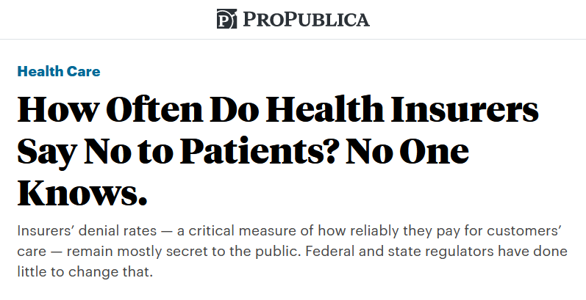
“Certainly not”
Me, responding to whether health insurers have left Vermont over prior authorization reporting requirements

Slide 27
Outline
Why does Vermont require this kind of reporting?
What kind of reporting does Vermont require?
How do we use this information?
How does Vermont regulate PA?
Future Steps?
  Expanded Data Collection?
  Legislative Action?

Slide 28
Why do this?
Reporting lets the public test claims made by health insurers about their prior authorization practices.
Notes:
Julia

Slide 29
Insurers claim that up to 10% of care may be inconsistent with standards of care or practice
In a 2023 presentation to the National Association of Insurance Commissioners, AHIP presented the results of a 2020-2021 study about 10% of physicians in the specialties of gastroenterology, orthopedic surgery, and nephrology provided care inconsistent with evidence-based standards of care:
Key arguments:
Each provider treats many patients, making the number of affected patients significant;
Improving adherence to standards of care results in better care and outcomes for patients;
Showing relative underperformance can influence under-performing providers to change their behavior.
https://www.ahip.org/documents/AHIP_AppropriatenessMeasures_2022.pdf
Notes:
Julia
Fraud, waste, and abuse – monitor that happens on the claims auditing side

Slide 30
What about the MCAS Reports?
The Market Conduct Annual Statement (MCAS) is a mandatory filing developed by the National Association of Insurance Commissioners (NAIC) that collects data on a state-specific, industry wide basis.
Pros:
All but two states require this filing
Captures consistent information about different kinds of denials
National (Cigna, Aetna, Humana, etc.) health plans file
Con: All states, including Vermont, consider this report to be confidential examination material.
8 V.S.A. § 23

Slide 31
Act 152 of 2016
Requires health insurers to submit information on the number and percentage of denials of service based on utilization review, including:
  pre-service review (i.e., prior authorization)
  concurrent review
  post-service review
Requires separate reporting for denials of:
  mental health services
  services for substance use disorder
  prescription drugs
Reports are required to be made public and posted on the Department’s website!
https://dfr.vermont.gov/industry/insurance/health-insurance/reports

Slide 32
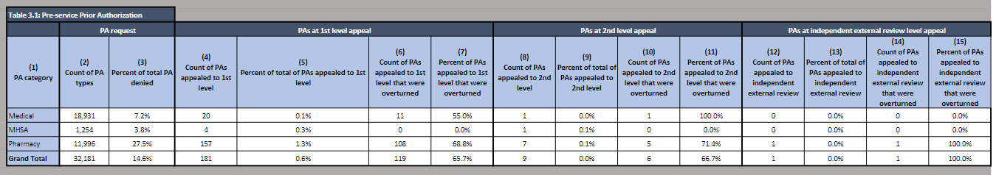
Example Act 152 filing from BCBSVT (2021). Full reporting includes similar tables for concurrent and post-service prior authorizations
PA requests and denial rate
PA appeals,
1st level
% overturned (PA granted)
PA appeals,
2nd level
% overturned (PA granted)
PA appeals,
external
% overturned (PA granted)
Notes:
Sebastian

Slide 33
How do we use this information?
Act 152 reports are not used in any specific regulatory process

Slide 34
Prior Authorization in Vermont

Slide 35
How does Vermont define Prior Authorization?
“Prior authorization” means the process used by a health plan to determine the medical necessity, medical appropriateness, or both, of otherwise covered drugs, medical procedures, medical tests, and health care services. The term “prior authorization” includes preadmission review, pretreatment review, and utilization review.
18 V.S.A. § 9418(15)

Slide 36
Mechanics of Prior Authorization
Clinician orders MRI for patient
Patient’s insurance requires PA before covering MRI
Clinician or office staff submit paperwork
Insurance company reviews request
Insurance company issues approval or denial
Patient gets MRI or, if PA is denied, decision may be appealed
The below diagram shows a simplified version of the PA process that referenced throughout this presentation:
PAs can apply to a wide range of services and prescription drugs.
PA requirements vary across health insurance plans based on what the insurance plan covers and insurer specific clinical guidelines.
Notes:
Julia
Clinician or patient can submit the prior auth
Sebastian mention fax vs online portals

Slide 37
Existing Vermont Laws and Rules for Prior Authorization
Federal and state law allows patients to seek external review of adverse benefit determinations. 8 V.S.A. § 4089f
VT requires health plans to review PA requirements at least annually and eliminate those that are no longer justified.
18 V.S.A. § 9418b
VT sets maximum response timelines at 48 hours for urgent and 2 business days for non-urgent requests.
18 V.S.A. § 9418b
Clinician orders MRI for patient
Patient’s insurance requires PA before covering MRI
Clinician or office staff submit paperwork
Insurance company reviews request
Insurance company issues approval or denial
Patient gets MRI or, if PA is denied, decision may be appealed
VT limits which services can require PAs, specifically related to medication-assisted treatment.
18 V.S.A. § 4754
VT requires a uniform PA form to standardize the PA process
18 V.S.A. § 9418b
*Note applicability of VT laws is limited to state regulated plans
Notes:
Sebastian.

Slide 38
Past Work on Prior Authorization
Year | Action
2013 | Standard Prior Authorization Forms (Act 171 of 2013) The Department of Financial Regulation (DFR) was tasked to work in consultation with the Department of Health Access (DVHA), the Vermont Medical Society (VMS), and health insurers to develop a “clear, uniform, and readily accessible” prior authorization form for use by all relevant Vermont providers. The uniform prior authorization form will be used for all types of medical treatment that requires prior authorization, including mental health and substance abuse. The uniform prior authorization form for medical service requests was finalized by September 1, 2013, as required.
2013-2016 | Prior Authorization Pilots In 2013, 18 V.S.A. § 9377a was added, directing the GMCB to work with health care professionals and health care insurers to implement a prior authorization pilot program. Through a workgroup convened by GMCB, the pilot program ultimately focused on eliminating PAs for two classes of drugs (PPIs and statins) and one procedure (non-contrast MRI of the spine for low back pain). This work laid the groundwork for future Gold Carding pilots.
2017 | Medicaid ACO Prior Auth Waiver In 2017, DVHA implemented a PA waiver through its Vermont Medicaid Next Generation ACO Program, negotiated with OneCare, for services included in TCOC. Modifications in 2018 to have waiver follow Medicaid member (not provider in VMNG) to reduce admin burden and confusion among providers (e.g. referrals). Information from DHVA Act 140 report
2018 | Primary Care Advisory Group provided recommendations to GMCB on PA [see next slide]
2020 | Legislature passes Act 140, requires gold carding pilots for insurers (with over 1,000 covered lives for major medical health insurance in VT) to exempt from or streamline certain PAs for a subset of providers (Sec. 11(a)).
2021 | GMCB convened a workgroup (AHS, DVHA, DFR, BCBSVT, MVP, HCA, OCV, HealthFirst, VAHHS, and VMS) to discuss opportunities for and obstacles to aligning and reducing PAs under APM (results in GMCB Act 140 Report)
2021 Annually | Prior Auth Attestation: Annually, starting in 2021, health plans shall attest to DFR and GMCB annually that it has completed review and elimination of PAs that are no longer justified or for which requests are routinely approved.
2021-22 | Reports under Act 140 about PAs: DVHA PA and Provider Exemptions Report; Opportunities for and Obstacles to Aligning and Reducing Prior Authorizations under the All-Payer ACO Model (GMCB); Opportunities to Increase the Use of Real-Time Decision Support Tools Embedded in Electronic Health Records to Complete Prior Authorization Requests for Imaging and Pharmacy Services (DFR)
2023 | Insurer PA and Gold Carding Reporting from each insurer required to implement a pilot program, due to GMCB, HHC, SH&W, and Senate Finance.
Notes:
Sebastian. Many reports and workgroups to look at PA in the last 10 years. See slide

Slide 39
Primary Care Advisory Group
PA Recommendations from 2018
Eliminate prior authorization for Vermont primary care providers (PCPs).
Prior authorization for medications prescribed by Vermont PCPs could be reconsidered and implemented only after the insurance and EMR industry create a reliable system for updating all formulary changes in real-time for point-of -care access for EMRs used in Vermont.
Insurers should provide education to both patients and PCPs regarding appropriate use criteria for imaging, medications, step-therapy, and specialty referrals.
Insurers should communicate with “outlier” PCPs whose prescribing or ordering patterns differ significantly from their peers after adjusting for patient mix and other relevant factors.
Notes:
Julia
As you can see, their recommendations are related to eliminating or streamlining prior auths for primary care providers because of the challenges associated with getting prior auths given changing requirements.
We’ve heard from PCAG for many years about the administrative burden of prior auths and the challenges the processes poses for getting their patients the care they need.
If the committee continues working on prior auth, I’m sure members of the PCAG would be happy to share their experiences with prior auth as it is a frequent subject at our meetings.

Slide 40
Future Steps
Notes:
Transition to alignment opportunities b/c leg tasked DFR to design reporting on individual PAs, etc.
Recommended instead to build on existing reporting structure (attestation) to gather more info about most frequent etc.

Slide 42
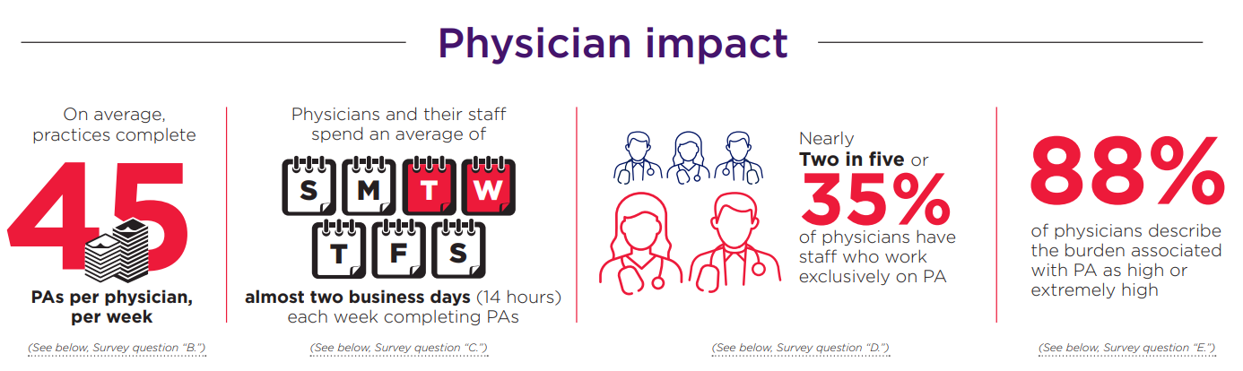
The Result: Provider Burden
2022 AMA prior authorization (PA) physician survey
Notes:
Note about admin staff + increased costs
Providers in VT highlight more challenges with PAs on the pharmaceutical side
Wait times – did not find that staff time to complete PAs was a factor in increasing wait times
From GMCB Act 140 Report: Although this report does not include pharmacy prior authorizations, some workgroup members and stakeholders noted pharmacy prior authorizations are more common and burdensome than service related prior authorizations. Pharmacy prior authorizations are especially complex to streamline since rebate contracts require prior authorization for competing products. Additionally, if there is no requirement for pharmacy prior authorizations, a provider may choose to prescribe a higher cost drug with no additional clinical benefit. There is also significant administrative burden to report and monitor prior authorization waiver programs. The workgroup agreed that, though it would be a significant undertaking, further exploration of prior authorization requirements for prescription drugs would be beneficial.

Slide 43
Act 183 Report
Real-Time PA / Clinical Data from VHIE
In 2022, BCBSVT participated in a pilot program with VITL, using clinical data in the VHIE to support PA requests
Approximately 36% of requests could be approved using VHIE data
For requests that could not be approved using VHIE data:
  the member’s clinical information was not in VHIE
  the information in the VHIE would have resulted a denial (3% of cases)
  out of state providers did not submit information to VHIE
  missing admission records, family histories, and medical histories
  missing clinical notes supporting an inpatient level of care or clinical need for services such as sleep studies, MRIs, and genetic testing

Slide 44
Takeaway:
in most instances where VHIE data could not be used to approve a PA request, it was because of deficiencies in data reporting, as opposed to legal or technological limitations with the data set.

Slide 45
Comparison to Act 152 Reporting

Slide 46
Forthcoming Developments
According to the Health Information Exchange (HIE) Strategic Plan, approved by the GMCB, VITL is working to expand the number of data types on the VHIE to include social determinants of health, mental health, and substance use disorder services.
  VITL is also partnering with the Agency of Human Services to incorporate public health data such as immunizations and vital records into the VHIE.
The Centers for Medicare and Medicare Services (CMS) proposed rules that, among other things, would require payers to and maintain a provider access application programming interface (API) to automate the process for determining whether a PA is required, identify documentation requirements, and ease the exchange of PA requests and decisions from electronic health record (EHR) systems.

Slide 47
Opportunities for Expanded Data Collection

Slide 48
Expand Data Collection?
DFR conducted extensive research to determine whether other states or the federal government had a pre-existing standard for insurers to submit information about their PA requirements:
  Several states, including Arkansas, Delaware, Indiana, Kentucky, Texas, Minnesota, and Virginia require insurers to post PA requirements to public websites in an accessible and searchable format, including a list of any supporting documentation the insurer requires to approve a request and applicable screening criteria.
  Under 8 V.S.A. § 9418b(d), health plans have to “post a current list of services and supplies requiring prior authorization to [their] website.”
  No states currently require insurers to submit their PA requirements to state regulators in a uniform format.
  The federal government does not collect any PA information and that it does not have a standardized format for PA language.
Notes:
Sebastian
Remind them that Act 183 directed us to collect information on insurer PA requirements for the purposes of identifying opportunities to streamline.

Slide 49
Can be done, but would be challenging
Act 183 does not mandate an ongoing reporting requirement.
Collecting a one-time snapshot of each insurer’s PAs for purposes of aligning and streamlining PAs would present several challenges:
Voluminous reporting due to large volume of procedure codes, with variation for diagnosis-related qualifications;
PA requirements are frequently added, removed, or changed;
Substantial differences between insurers as to the clinical criteria applicable to each service that requires PA.
For these reasons, a one-time snapshot of each insurer’s PA requirements would not meaningfully support the analysis of how to achieve the goal of streamlining the PA process, while imposing a substantial administrative burden on insurers to submit the data.
Notes:
Sebastian
DFR noted that Act 183 does not mandate an ongoing reporting requirement like Act 152. However, there are a large volume of procedure codes and prescription drugs that require PA; PA requirements are frequently added, removed, or changed; and there are substantial differences between insurers as to the clinical criteria applicable to each service that requires PA. For example, the drug Ketamine is an anesthetic approved by the FDA for that use in 1970. It is not FDA-approved for the treatment of any psychiatric disorder, 9 although there are studies suggesting it can be used to treat depression. 10 BCBSVT does not require PA for Ketamine when used as an anesthetic but does require it when used to treat depression. 11 Cigna excludes Ketamine from coverage altogether when used to treat depression, considering it to be an experimental or investigational use of the drug. 12
The fact that VEHI is often not sufficient to approve PAs underscores the complexity in reporting

Slide 50
The answer: be more specific!
Going forward, DFR and GMCB will require insurers attesting to § 9418b(h) compliance to submit the following:
A general description of the standards used by insurers to evaluate PA requirements.
A list of services for which PA requirements were eliminated or added during the preceding plan year and the rationale for changing those requirements.
A list of the ten most requested PA and the PA approval rate for those PA; and
The percentage of urgent and non-urgent PA requests granted because processing time exceeded the statutory timeframes established under 18 V.S.A. § 9418b(g)(4)
Notes:
Sebastian
In the gold carding reports MVP and BCBSVT said that they do an ROI analysis on PA requirements. We’re going to want a thorough understanding of their processes.

Slide 51
Opportunities for Legislative Action
Notes:
Sebastian

Slide 52
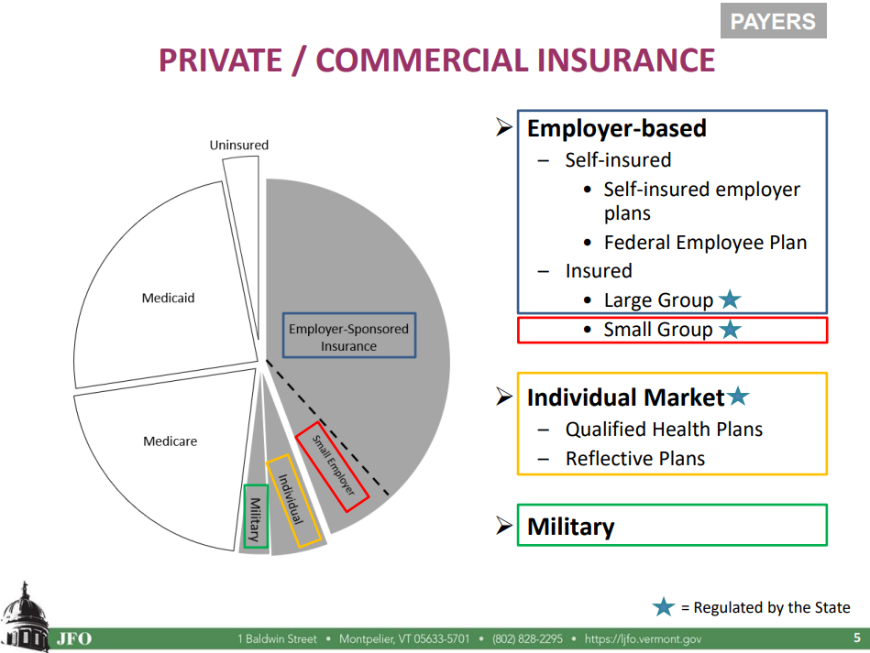
Scope of Legislative Action
As with other policy topics considered by the committee, any legislative action will be limited to state regulated plans.
As it relates to PAs, this means that changes to streamline processes and reduce administrative burden will not apply to all patients seen by Vermont providers.
  For example, changes will not apply to self-insured employer plans
Screenshot from Nolan Langweil’s presentation to HHC on 1/17/2023
Notes:
Sebastian

Slide 53
Opportunities for Legislative Action on Prior Authorization
Consider amending
§ 9418b(g)(4) to decrease the timeframe for health insurers to respond to completed PA requests for urgent PAs to 24 hours, as currently required by at least 10 states
Expand Gold Carding programs to exempt providers from PAs for certain services
Clinician orders MRI for patient
Patient’s insurance requires PA before covering MRI
Clinician or office staff submit paperwork
Insurance company reviews request
Insurance company issues approval or denial
Patient gets MRI or, if PA is denied, decision may be appealed
Limit how insurers apply step therapy protocols for prescription drugs, which has been done in other states including MA.
Improve quality and quantity of clinical data in the VHIE
Consider prohibiting insurers from requiring reauthorization during the current plan year for preventative services.
Notes:
Julia
- Gold Carding – PCAG interest in expanding gold carding.
- Step Therapy
Seb
- VHIE
- reauth
- timeframes

Slide 54
Questions for our speakers?
Submit your questions in the Q&A chat
@HealthValueHub www.HealthcareValueHub.org
Notes:
We will now move to the Q&A section—if you have any questions you’d like to ask our panelists, please submit them in the Q&A chatbox. I’ll get us started with a question that was asked ahead of time,

Slide 55

Thank you!
  To our Speakers: Kaye Pestaina, Caitlin Donovan, and Sebastian Arduengo
  To our funder, the Robert Wood Johnson Foundation
Register for future webinars at: HealthcareValueHub.org/events
Notes:
I’d like to end by thanking our speakers Kaye Pestaina, Caitlin Donovan, and Sebastian Arduengo for taking the time to share their expertise with us and to our funder, the Robert wood johnson foundation.

