Slide 1
Public Health Emergency Unwinding: Implications and Strategies for Support
May 15, 2023

Slide 2
Welcome and Introduction
Britt Sanderson, MPH, MS
Policy Analyst
Healthcare Value Hub

Slide 3
Housekeeping
Thank you for joining us today!
Please stay muted until the Q&A segment
The webinar is being recorded
Technical issues? Email Elise Lowry at Elise.Lowry@Altarum.org

Slide 4
3:00 pm: Welcome and Introductions
3:05 pm: Upcoming Changes to Medicaid: What’s At Stake
  Allie Gardner, MPP
  Senior Research Associate at the Georgetown University McCourt School of Public Policy
3:20 pm: Strategies for Support - Public Health Emergency Unwinding State Case Study
  Krissy Azeem, MPH, PMP
  Senior Director, Delivery System Transformation, Altarum
3:35 pm: Spotlight - Impact on Dual Eligible Individuals and their Caregivers
  Sarah Barth, JD
  Executive Director, Medicare-Medicaid Services for States (AMMS)
3:45 pm: Questions and Answers
3:55 pm: Wrapping Up

Slide 5
Upcoming Changes to Medicaid: What’s At Stake
Allie Gardner
May 19, 2023

Slide 6
How Did We Get Here?
Congress passed the bipartisan Families First Coronavirus Response Act (FFCRA) in March 2020; which:
  Required states to keep most enrollees on Medicaid during the public health emergency (PHE) as a condition of 6.2% increase in federal funding (FMAP)
Dual federal COVID-19 emergencies (Presidential-declared national emergency and HHS Secretary-declared public health emergency) allowed for widespread emergency authorities and flexibilities
  The FFCRA and many of its provisions were originally linked to end of the federally declared COVID-19 public health emergency (PHE)
  Declared emergencies will end May 11

Slide 7
Flexibilities Adopted During the PHE
CMS approved section 1135 waivers and Medicaid and CHIP disaster SPAs, among other flexibilities, to help states respond to COVID-19 pandemic
Every state had at least one emergency authority approved. These included:
  Expanding telehealth (e.g. establishing payment parity, “audio only” communication)
  Improving access or increasing benefits - (e.g. reduce limits on drugs and/or number of services)
  Removing barriers to coverage and care – (e.g. suspending premiums and copays)
Flexibilities will end the day the PHE ends, though states can take steps to permanently adopt some authorities

Slide 8
Ending Medicaid Continuous Coverage
“Unwinding”
Other Requirements
States must check eligibility for all Medicaid enrollees
    Coverage is terminated if renewal is not completed
Compliance with all federal renewal requirements, take steps to update contact information and attempt to contact enrollee before termination for returned mail
CMS has new enforcement authority under CAA
Prohibition on more restrictive eligibility and enrollment standards
Timely reporting of specific Medicaid, CHIP, and Marketplace related data
ALL states must report required data regardless of choosing to forgo enhanced FMAP
    Financial penalties for not reporting
CMS must post the state-level data

Slide 9
What’s at stake?
Coverage for ~93 Million People
Medicaid/CHIP enrollment has grown by around 30 percent between Feb. 2020 and Dec. 2022
92.6 million people were enrolled in Medicaid and CHIP in Dec. 2022
More than half of children in the US (~42 million) are insured through Medicaid or CHIP, most in Medicaid
According to analysis from ASPE,
2.7M adults and
3.9M children
are at risk of losing coverage despite remaining eligible
Disenrollment may be higher due to the unprecedented nature of the unwinding

Slide 10
Risk of Procedural Disenrollments
During the renewal process, enrollees may not:
    Receive a renewal notice
    Understand their renewal notice
    Receive the notice in their preferred language
    Submit renewal information timely
Call centers wait times may be unreasonable with enrollees not able to get answers
Medicaid agencies may not be able to timely process documents
Many will reapply, leading to additional work for agencies, gaps in coverage, and increased costs
45% of all Medicaid enrollees will likely be disenrolled for procedural reasons.
By group:
74% of children,
52% of Latinos, &
48% of Black non-Latinos
may lose coverage despite still being eligible.

Slide 11
Transitions to Other Coverage
Renewal processed successfully but enrollee is no longer eligible for coverage
The administration has taken steps to eliminate barriers for transitioning to other coverage like:
  Fixing the family glitch
  Creating a special enrollment period for consumers losing Medicaid coverage due to unwinding
However, other challenges remain:
  Affordability
  Complicated application and plan selection process
  Moving children from Medicaid to CHIP

Slide 12
Warning Signs
Enrollees are not receiving renewal notices in the mail
Notices are difficult to understand and/or do not clearly communicate what actions are needed to retain coverage
Call wait times are unreasonable
Staff at call center are unable to provide needed assistance
Individuals being transferred to the Marketplace are not being enrolled in plans
Limited access to enrollment assistance
Difficultly renewing coverage through one or more modes (i.e. online, over the phone)
Backlogs in processing of applications
Lack of transparency or rapid response from the state
Large numbers of procedural disenrollments
  Based on state data or stories from enrollees

Slide 13
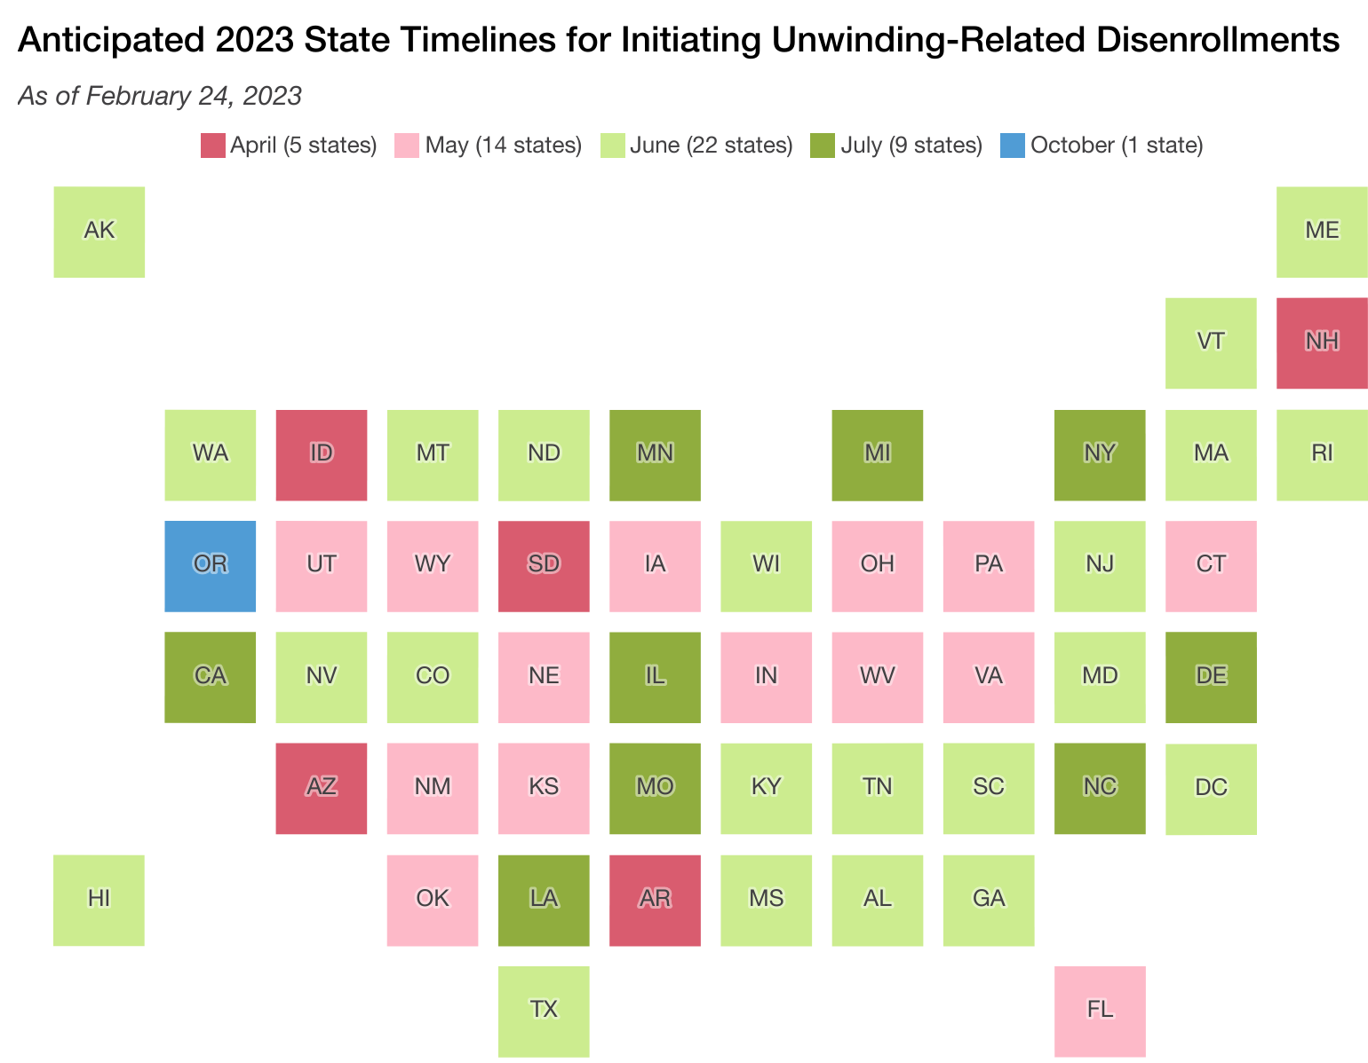
What is Your State Doing?

Slide 14
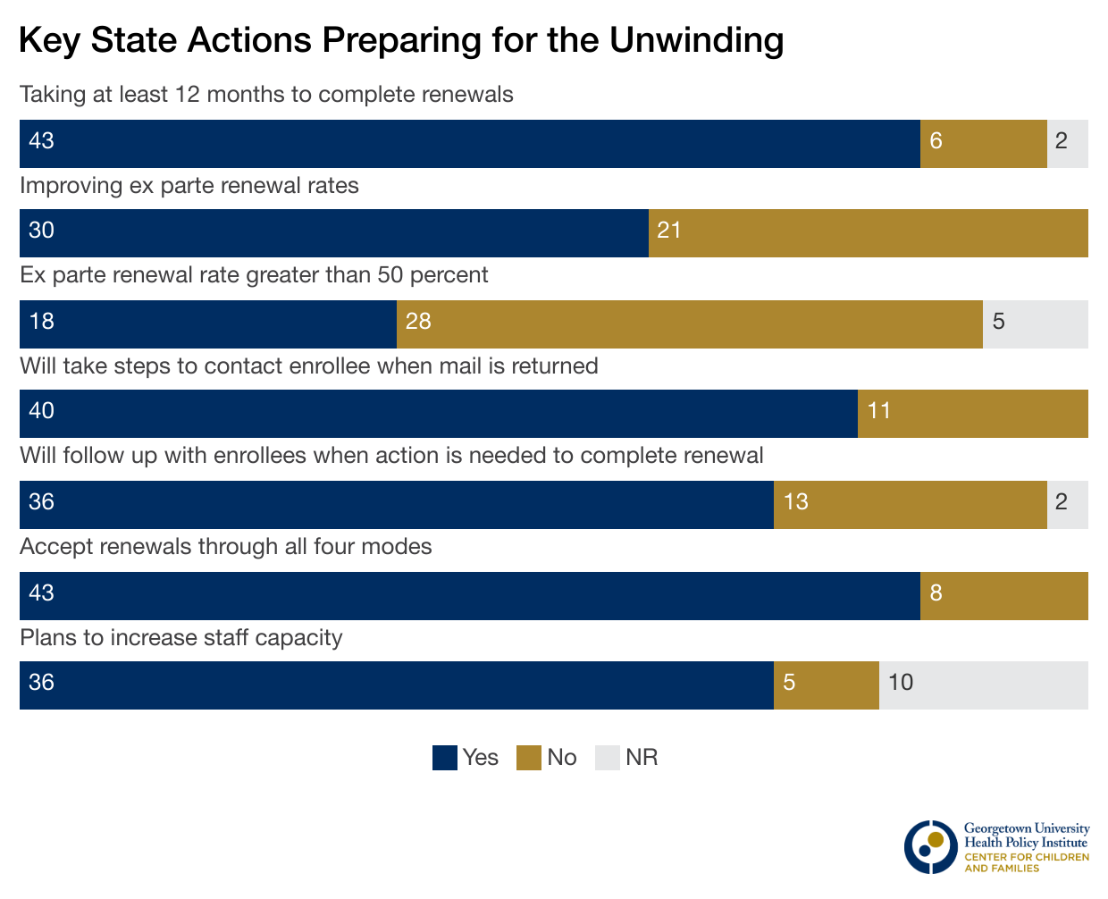
What is Your State Doing?
All states have been conducting update contact info campaigns
Almost every state has posted communications materials (50)
Important for stakeholders to use consistent messaging
Most states are posting at least a summary of plan (48)
But fewer are committed to posting key data (28)
More than half of states’ renewal reports (30) have been published by the state or accessed through public records pathways

Slide 15


Public Health Emergency Unwinding:
State Case Study

Slide 16
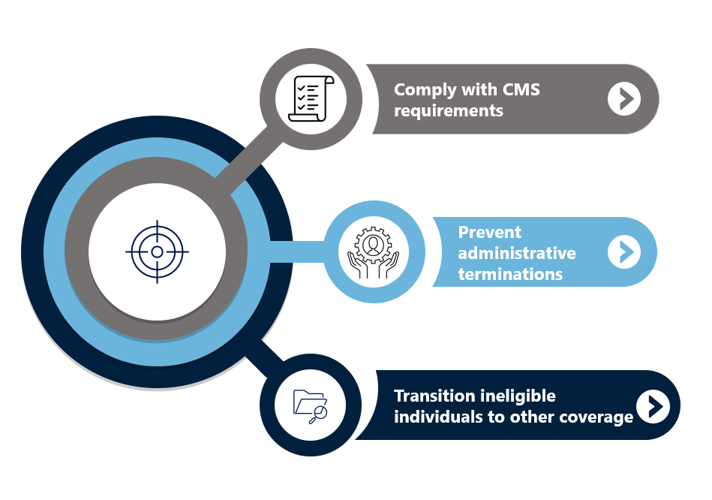

Kentucky’s PHE Unwinding Goals
Notes:
Talking Points for Stakeholders:
Directed for Providers:
As the PHE ends, the state of Kentucky is focusing on making sure that all providers understand the flexibilities that will be ending, continued for a short period, or established permanently. Especially, how these will impact how providers deliver services and administrative actions that will be required to ensure providers can continue to deliver Medicaid services. The state wants to make sure that providers have all the information needed to support their patients through the unwinding and ensure their practice can seamlessly continue.
Directed for Consumers:
The state of Kentucky is aiming to make sure that all Medicaid beneficiaries understand what actions are required to ensure they don’t get administratively terminated – or deemed ineligible for Medicaid just because of an administrative issue in the system. This includes making sure consumers have updated their contact information in Kynect and are on the look out for any communications coming from the state. If there are reasons outside of administrative issues that lead a consumer to be determined to be ineligible for Medicaid, KY is focusing on making sure consumers understand their options for alternative coverage and are enrolled in the appropriate plan to ensure they don’t have a lapse in coverage.
Directed to Partners:
As the PHE ends, the state of Kentucky is focusing on making sure that all partners have the information to work with their audiences to communicate what is going to occur. Partners in the community have a unique role of supporting consumers and providers and the state recognizes that all stakeholders should be up to speed and informed and will aim to ensure that all parterns have what they need to support the goal of decreasing churn and avoiding lapses in coverage for beneficiaries.

Slide 17
Key Strategies – Kentucky’s Approach
Renewal Caseload planning
Outline renewal process and what Kentuckians can expect
Avenues for help across the state
Data monitoring and progress tracking
Coordination across sister agencies and community partners
Transparency around upcoming changes
Communication, communication, communication!

Slide 18

Medicaid Renewal Caseload Planning
Priority: May-October
Priority: June
Priority: July - ongoing
All individuals requiring renewal will be distributed across a 12-month period, based on the state’s renewal distribution plan
May – June – July – August – September – October – November – December – January – February – March – April
Medicare-eligible population will be prioritized in the first 6 months to enroll in Medicare
Special circumstance population (over 14K beneficiaries) will be prioritized in June
QHP-eligible population will be engaged starting June 2023 for the duration of the renewal process

Slide 19
KY Medicaid Renewal Process (for Members)
March
May renewals will receive a text and/or email notification that their renewal month is approaching
April
May passive renewals successfully verified issued notice of renewal
May
May active renewals and passive renewals with RFI will issue notice of renewal or denial by month end date
May passive renewals not verified issued request for information about 60 days prior to end date
June passive renewals successfully verified issued notice of renewal
June passive renewals not verified issued request for information about 60 days prior to end date
May renewals start processing
June renewals will start processing
May active renewals issued renewal packet about 60 days prior to end date
June active renewals issued renewal packet about 60 days prior to end date
June renewals will receive a text and/or email notification that their renewal month is approaching
July renewals will receive a text and/or email notification that their renewal month is approaching
June
June active renewals will issue notice of renewal or denial by month end date
July renewals will start processing
July passive renewals successfully verified issued notice of renewal
July passive renewals not verified issued request for information about 60 days prior to end date
July active renewals issued renewal packet about 60 days prior to end date
August renewals will receive a text and/or email notification that their renewal month is approaching
DID YOU KNOW?
Members will receive a communication:
About 90 days before their renewal end date and/or
If there’s no response by the 15th of their renewal month
Notice of Eligibility
Request for Info
Notice of Eligibility
Notice of Eligibility
Renewal Packet
Request for Info
Request for Info
Renewal Packet
Renewal Packet

Slide 20
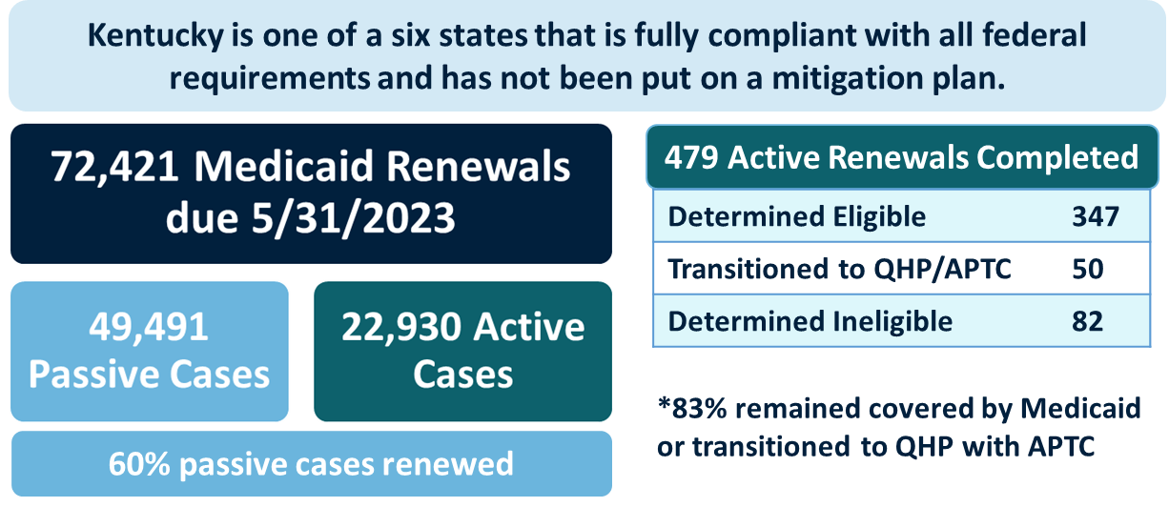
Renewal Cases Data - Updates

Slide 21
Proactive Approaches to Help Members
MCO Member Support
Contact Center Direct Outreach
Kynectors and Insurance Agents
Tracking returned mail
Providers
and Associations
KLOCs and KYHealthNet Reports
Coordination with DAIL and SHIP
Community Advocacy Organizations

Slide 22
PHE Flexibilities
This is not a full list of all flexibilities. Please reference the KY PHE Flexibility Tracker for full information.
Ending May 11, 2023
Extended through PHE Unwinding
  Suspension of provider revalidations
  Use of unlicensed facilities as alternative locations
  Hospital 20% add-on to DRG for COVID-19 diagnosis
  Nursing Facility $270 per diem add-on
  Second Presumptive Eligibility (PE) period in CY
  LTC Resource disregard
  120-day period to file an appeal and for the state to make a decision
  Telehealth audio-only, non-HIPAA compliance platforms (CAA, 2023)
  Re-enrollment of member MCO if within 120 days
Permanently Implemented
  Nurse Aide applicants use of I-9 instead of Social Security Card (907 KAR 1:250)
  Expanded telehealth (907 KAR 3:170)
NOTE: HCBS Appendix K flexibilities do not end until 6 months after the end of the PHE

Slide 23

Communication is Key!
Group meetings / town halls
Websites
US mail
TV
Social media
Press Releases
Calls & Texts
Brochures
Radio
Posters
Newspapers
Email blasts
Members * Providers * State Agencies * Managed Care Organizations * Advocacy & Community Based Organizations

Slide 24
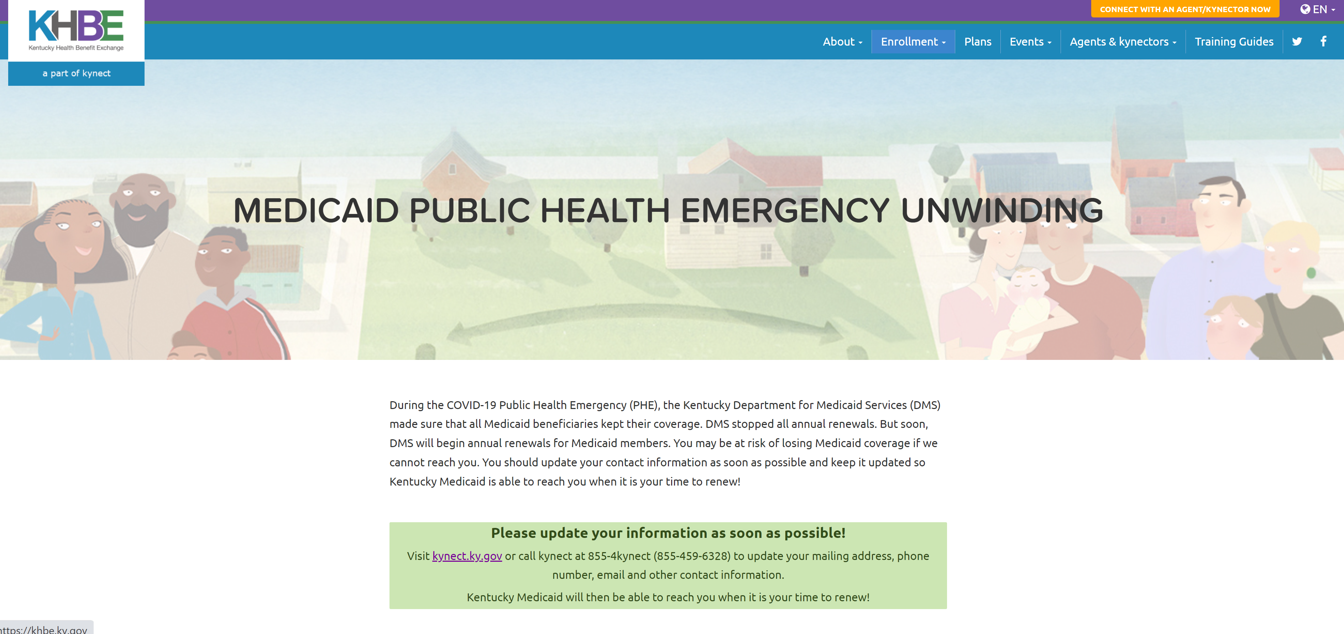
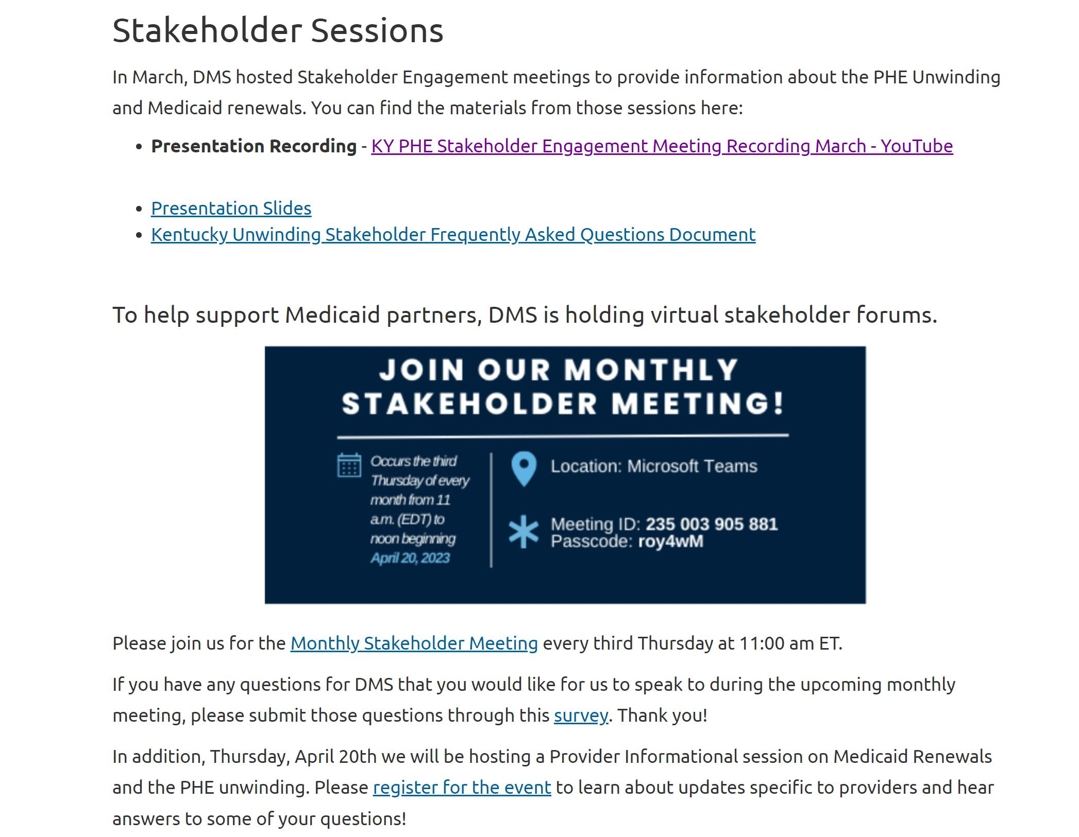
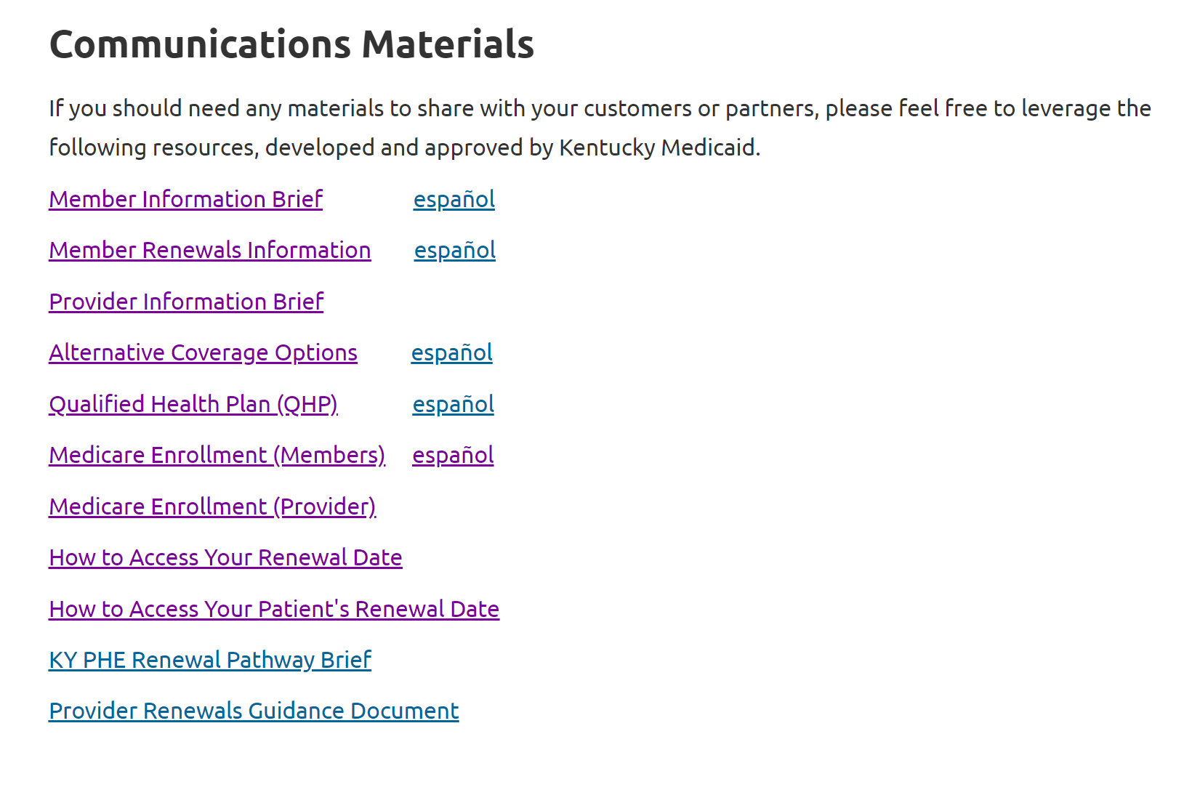
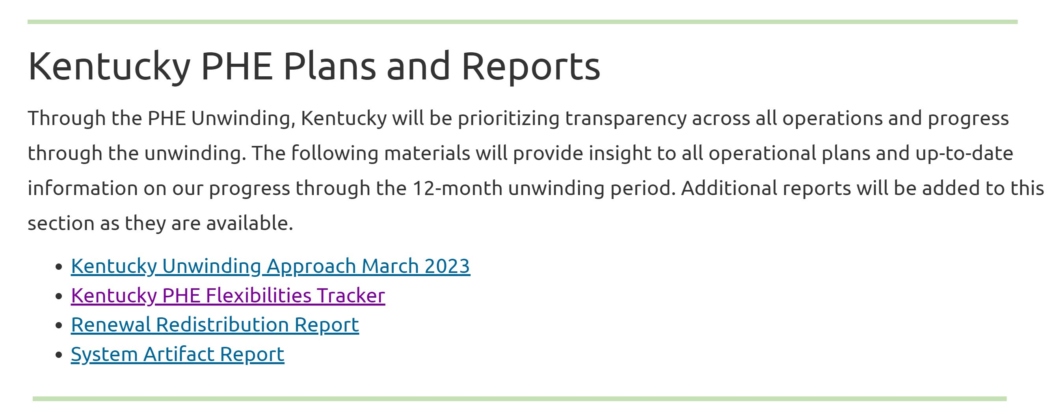
KY PHE Website Resources
https://medicaid.unwinding.ky.gov
Stakeholder Session Information
KY PHE Reports
FAQs
Medicaid Member Information
Medicaid Provider Information
Communication Materials

Slide 25
Additional Resources for Kentuckians
CHFS Social Media
Facebook,
Stakeholder Meetings
Ongoing Stakeholder Meetings – 3rd Thursday @ 11:00 ET
Twitter, and
Instagram
Kentucky’s Medicaid Renewals and PHE Unwinding Website - MedicaidUnwinding.ky.gov

Slide 26
Public Health Emergency Unwinding – Impact on Dual Eligible Individuals and their Caregivers
May 19, 2023
Sarah Barth, Executive Director
Altarum Medicare-Medicaid Services for States

Slide 27
Altarum Medicare-Medicaid Services for States (AMMS)
Helping States Build Better Programs for Dually Eligible Individuals
Altarum Medicare-Medicaid Services for States (AMMS) is a non-profit organization that helps states create financially sustainable solutions to advance health, health equity, wellness, and community-based, independent living for dually eligible individuals (individuals eligible for Medicare and Medicaid).
Assess and Partner
With States
Enhance and Build
State Capacity
Provide Policy and Program Administration Services
Meeting them where they are along the continuum of dual integration expertise and programming
Improving coordination and integration across the two programs to improve individuals’ experience of care and quality of life, address cost shifting between the two programs, and ensure Medicare is maximized as primary payer of services and supports
From national experts and tailored to the needs of each state and their dually eligible populations, including:
Strategy and Program Design
Administration and Operations
Communications

Slide 28
Dually Eligible Individuals
More than 12 million people are dually eligible, qualifying for both Medicare and Medicaid.
Medicare Eligibility
Workers, their dependents and their survivors are eligible for Medicare due to age or disability
Age 65 or older, OR
Under age 65 with a disability, OR
Are of any age with End Stage Renal Disease
Medicaid Eligibility
People are eligible if they meet criteria for eligibility pathways defined by the populations they cover and the financial criteria that apply
Is a member of an eligible group (adults with disabilities, older adults, children and families, people who are pregnant, Other – varies by state) AND
Meet income and asset requirements (varies by eligibility group and state)

Slide 29
Medicare Versus Medicaid Service Coverage
  Medicare pays before Medicaid for overlapping services. Medicaid is payer of last resort.
  Medicare mainly covers medical services such as professional (e.g., physician) services, inpatient and outpatient acute care, and post-acute skilled-level care.
  Medicaid wraps around Medicare’s coverage by providing coverage of some services not included in the Medicare benefit, and others included but with benefit limits (Medicaid benefits vary by state) and/or financial assistance in the form of payment of Medicare premiums and cost sharing
Notes:
Medicare is a federal program with uniform eligibility rules and a standard benefit package
Medicaid is a joint federal-state program with eligibility rules and benefits that vary by state

Slide 30
Dual Eligible Population Characteristics
  Dual Eligible Individuals are diverse and often high need.
59% are female
Proportionately more Black (21 %) and Hispanic (17%) than non-dual Medicare individuals (9% and 6%)
More likely to report being in poor health than non-dual Medicare individuals (13% vs 4%)
34%, or about a third, did not graduate from high school*
70% have been diagnosed with three or more chronic conditions
41% have a behavioral health disorder
Over 40% use long-term services and supports (LTSS)^ (Nursing and home and community-based services - HCBS)
Sources: #February 2023 MedPAC MACPAC Dually Eligible Data Book; ^ Dually Eligible Individuals: The Basics (integratedcareresourcecenter.com)
Notes:
70% have been diagnosed with three or more chronic conditions, such as: Diabetes • Alzheimer’s disease • Heart disease • Intellectual disabilities
41% have a behavioral health disorder, such as: Depression • Bipolar Disorder • Anxiety • Schizophrenia
Over 40% use long-term services and supports, such as: Nursing facility services • Home and communitybased services

Slide 31
Impacts of the Pandemic on Medicaid HCBS
The COVID-19 pandemic highlighted state challenges providing Medicaid HCBS, with increased workforce shortages during a time of increased demand for HCBS. Time-limited flexibilities and funding were provided to states, but it is uncertain how to pay for some longer term.
During the pandemic more people needed HCBS with the growing aging population and desire to stay home and out of nursing facilities
States were provided time-limited or temporary flexibilities to address the workforce shortage via the American Rescue Plan Act (ARPA) and COVID-19 public health emergency (PHE) authorities
  Rate increases
  Increased self-direction
  Increased family caregiving opportunities
  Increased family caregiver supports
  Streamlined enrollment processes
  Increased Telehealth
  Expanded service coverage
Source: Ongoing Impacts of the Pandemic on Medicaid Home & Community-Based Services (HCBS) Programs: Findings from a 50-State Survey | KFF
Notes:
HCBS: medical and nonmedical services that assist Medicaid members with physical, mental and other chronic conditions – ALL prevalent among the dual eligible population.
HCBS provider workforce shortage: home health aides, PCAs, direct support professional and community-based mental health providers.
ARPA – time-limited enhanced 10% FMAP for HCBS April 1, 2021 and March 31, 2022 (must spend by March 31, 2025)
PHE – temporary flexibilities afforded to states during PHE
Rate increases – half required increased provider payment rates be passed through to worker waiges, more than half of the states plan to continue after temporary funding or authorities expire
Increased self-direction: All states offer at least one HCBS program with this option
Increased family caregiving opportunities: Almost all states allow legally responsible relative to be paid caregivers (includes spouse, parent or adult child)
Increased family caregiver supports: Respite care, caregiver training, and caregiver counseling/support groups (Some form of these services are now offered by all states)
Streamlined enrollment processes: allowed for virtual eligibility determinations
Increased telehealth: Likely to continue post-PHE
Expand service coverage: by increasing utilization limits (more likely to end) or offering new waiver services e.g. home delivered meals most frequent one added some states will continue but others will end the services when the PHE ends.
There is bipartisan consensus on broad policy goals to eliminate waiting lists for HCBS services, increasing opportunities for family members to be paid caregivers, increasing wages for all HCBS providers, and supporting more people to live in the community but not on how pay for them.
Pandemic placed a spotlight on state challenges providing Medicaid HCBS, but also provided opportunities for change. The report shares it will be seen whether changes undertaken will lead to long-term changes.

Slide 32
Post-PHE Dual Eligible Medicaid Eligibility Redeterminations
Dual eligible individuals will need specialized outreach and communication about Medicaid redeterminations that will begin again with the ending of the PHE.
Dual eligible individuals have higher rates of disability, require more assistance with ADLs and have more limited English proficiency
Administrative reasons for losing Medicaid coverage will result in loss of services they depend upon – for example, HCBS, non-emergency medical transportation, dental care
There are also financial consequences
  They will lose Medicaid coverage of payment of Medicare cost-sharing
  Some individuals will lose eligibility for Medicare Part D Low-income Subsidy leading to higher drug costs
Individuals enrolled in Medicare Advantage Dual Eligible Special Needs Plans (D-SNPs) will be disenrolled from their D-SNPs with loss of Medicaid eligibility leading to potential confusion and disruption in care
Sources: Supporting Your Dually Eligible Members During Redetermination (healthmine.com); Unwinding Medicaid Continuous Coverage Protections: Implications and Advocacy for Individuals Dually Eligible for Medicare and Medicaid (justiceinaging.org)
Notes:
List ways to address these issues/concerns from the two publications as talking points.

Slide 33
Questions and Answers

Slide 34
Thank you to our speakers, our attendees, and our funder, the Robert Wood Johnson Foundation.

